Slide 1

Clustering Solar Energy Production Zones
“Harnessing the Sun: Smarter Zones, Greater Efficiency”
January
2025

Slide 2

Agenda
A Roadmap to Smarter Solar Energy Clustering
Introduction
Data Overview
Data Preprocessing
Data Visualization
Model Selection
Geographic Visuals
Conclusion

Slide 3
Introduction
As the demand for renewable energy continues to rise, optimizing solar energy production is becoming increasingly crucial. Solar farms are widely distributed across different regions, but not all locations generate the same level of efficiency. To maximize energy output and operational effectiveness, clustering solar energy production zones offers a strategic approach to grouping similar locations based on key factors such as solar irradiance, geographical conditions, and infrastructure availability.
By implementing clustering techniques, we can identify high-performance zones, streamline energy distribution, and enhance grid stability. This data-driven approach not only improves efficiency but also contributes to a more sustainable and cost-effective solar energy network.
In this presentation, we will explore: ✅ The importance of clustering in solar energy production ✅ Methods for grouping solar farms using data-driven techniques ✅ The benefits of optimizing solar energy clusters ✅ Real-world applications and case studies
Through this structured approach, we aim to unlock the full potential of solar energy and drive the transition toward a greener future. 🌞⚡

Slide 4
Project Benefits:
Strategic Targeting: Identify regions with high solar energy potential, allowing for targeted sales and marketing efforts.
Improved Project Feasibility: Streamline project planning by pre-identifying areas with historically high production for client proposals.
Data-Driven Decision Making: Gain valuable insights into solar resource variability across the region, informing business decisions regarding project allocation and resource deployment.
Deliverables:
Clustering Algorithm Implementation: Develop and implement a machine learning clustering algorithm to group geographical areas based on their total solar energy production.
Interactive Map Visualization: Create an interactive map visualization tool displaying the identified energy production zones across the region.
Project Report: Document the methodology, findings, and recommendations for utilizing the identified zones for future projects.

Slide 5
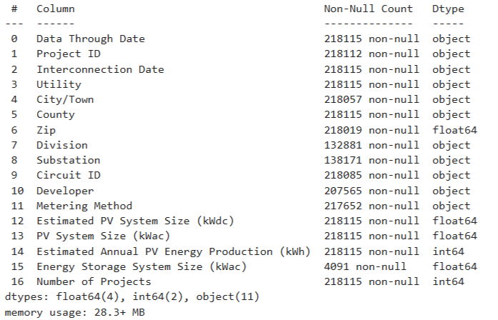
Data Overview
The data set includes categorical , numerical features , geographical information , ID , etc.
Dataset Dimensions
Number of rows : 218115
Number of columns : 18
Challenges
Missing Values
Data-types
Outliers

Slide 6
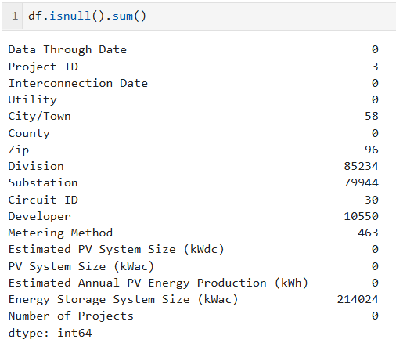
Data Pre-processing
Identifying missing values : Used df.isnull().sum() to check for missing data in each column.
High missing values : Division , Substation , Energy Storage system size(kwac).
Moderate missing values : Developer.
Minimal missing values : Project ID , City/Town, zip ,Metering Method , Circuit ID.

Slide 7
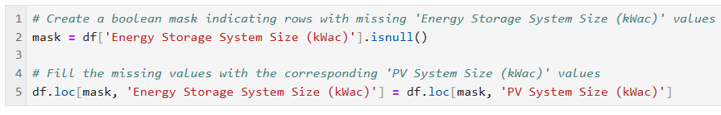
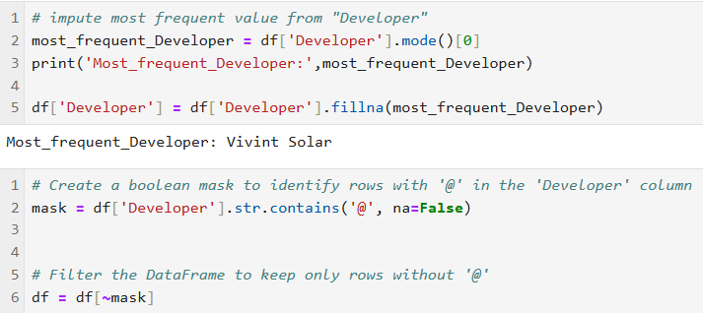
Data Pre-processing
High missing values : Division and Substation consist around 40% missing values. By using
df.drop(['Division', 'Substation'],axis=1) I dropped columns.
For Energy Storage system size(kwac) I filled corresponding ‘PV system size (kwac)’ values.
Moderate missing values : For Developer column I impute most frequent method for missing values and column contains E-mail id in some rows for identifying those I used Boolean mask.

Slide 8
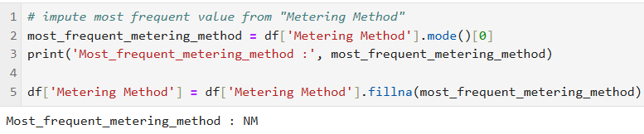
Data Pre-processing
Minimal missing values : For Project ID , City/Town, zip and Circuit ID I used drop method df.drop([‘Project ID’ , ‘City/Town’, ‘zip’ , ‘Circuit ID’ ],axis =1).
For metring method I impute most frequent value from “Metering Method”

Slide 9
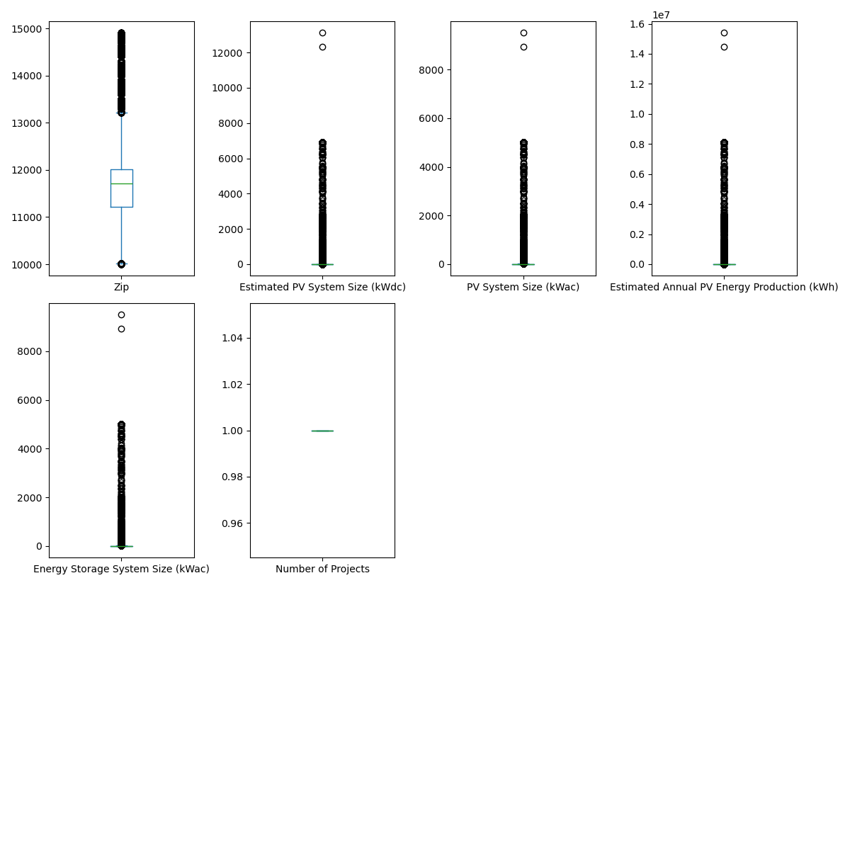
Data Pre-processing
The provided boxplot visualization represents the distribution of numerical variables related to solar energy production zones
Zip Code : The distribution of zip codes shows a wide range, indicating that the dataset includes solar energy projects from various locations.
Estimated PV System Size (kWdc) & PV System Size (kWac) : Both distributions show a large number of small-scale systems with a few extreme outliers at the upper end. This suggests that most solar projects are relatively small, while a few significantly larger installations exist.
Estimated Annual PV Energy Production (kWh) : Similar to system size, energy production is mostly concentrated at the lower end, with a few high-production solar projects appearing as outliers.
Energy Storage System Size (kWac) : The majority of energy storage systems have smaller capacities, with some large-scale installations appearing as outliers. This may indicate that storage adoption varies widely between projects.
Number of Projects: This variable seems to have minimal variation, indicating that most records in the dataset might have a similar count of projects.

Slide 10
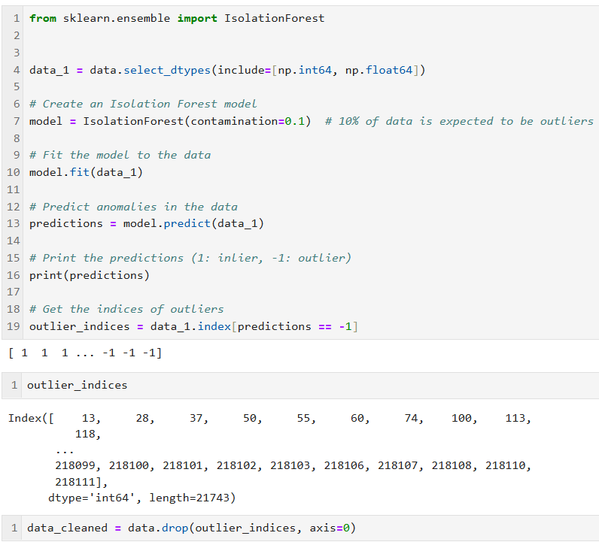
Data Pre-processing
Isolation Forest is an unsupervised machine learning algorithm designed for anomaly detection. It's particularly effective at identifying outliers in high-dimensional datasets.
Algorithm detects 21,743 anomaly in dataset name as outlier_indices.
By drop method I dropped this indices we get our clean data 196216 Rows and 15 columns.

Slide 11
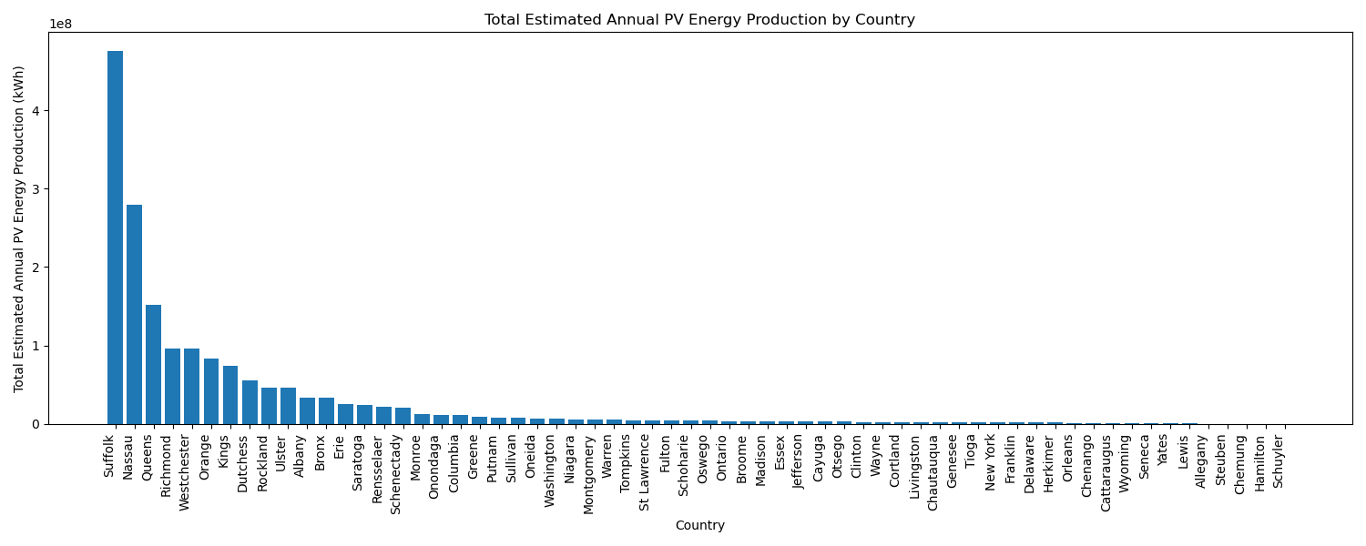
Data Visualization
The image shows a bar chart titled "Total Estimated Annual PV Energy Production by Country." The x-axis lists various countries or regions, while the y-axis represents the "Total Estimated Annual PV Energy Production (kWh)."
The bars are arranged in descending order of energy production, with the first few countries/regions showing significantly higher production levels compared to others. The chart visually conveys the variation in estimated annual PV energy production across different locations.

Slide 12
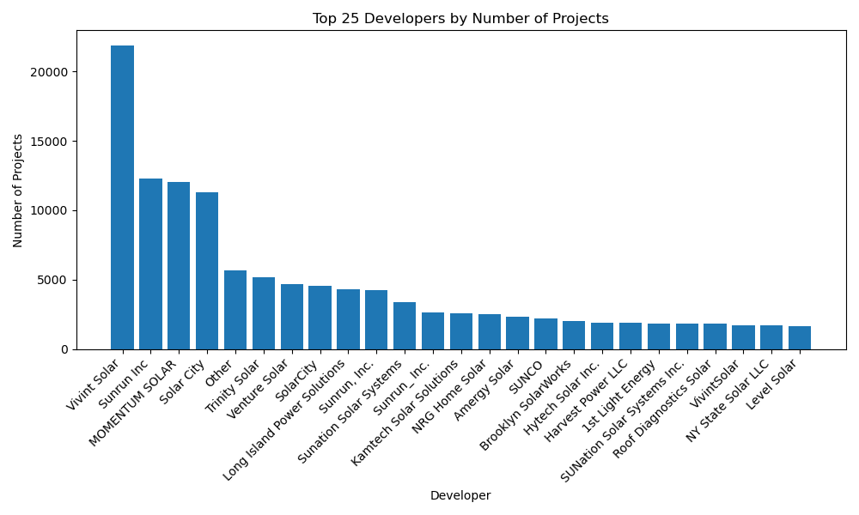
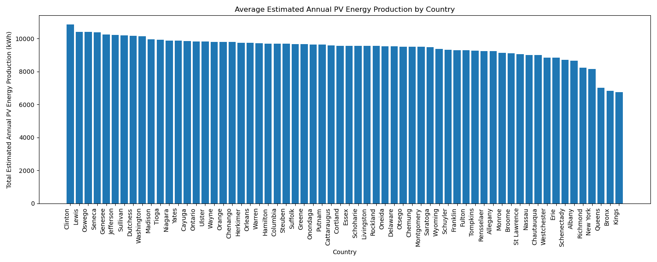
Data Visualization
The graph shows that Top 25 Developers by numbers of projects. The top few developers have a significantly higher number of projects compared to the rest .Vivint Solar appears to be the leading developer with the highest number of projects.
The graph shows Average estimated annual PV energy production by country. Clinton appears to have the highest average estimated annual PV energy production.

Slide 13
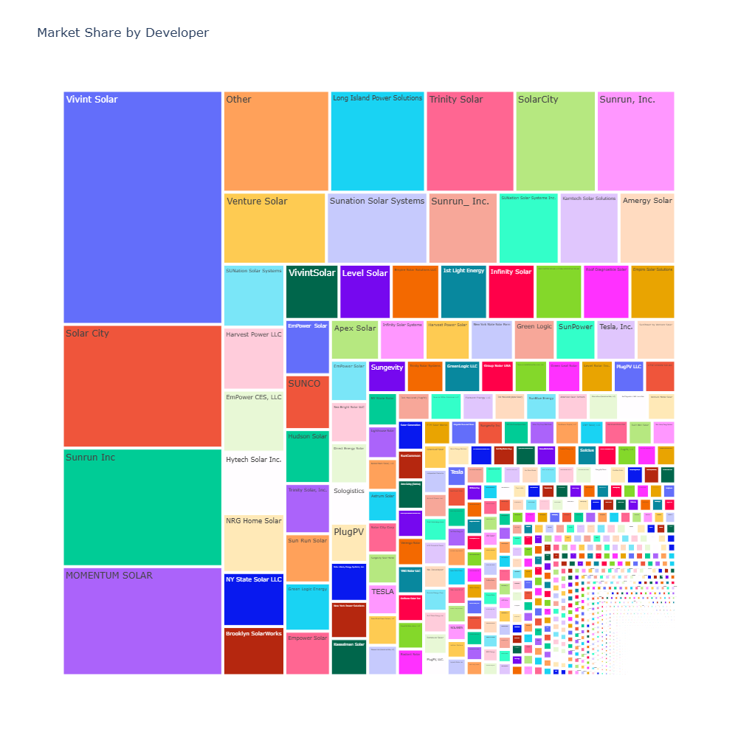
Data Visualization
This image is a tree map cloud that highlights the most market share by developer in dataset.
Vivint Solar and Solar City appear to have the largest market share, represented by the largest rectangles.
There are a large number of smaller developers with relatively smaller market shares.
The tree map provides a clear visual representation of the market dominance of a few key players and the presence of a long tail of smaller developers.

Slide 14
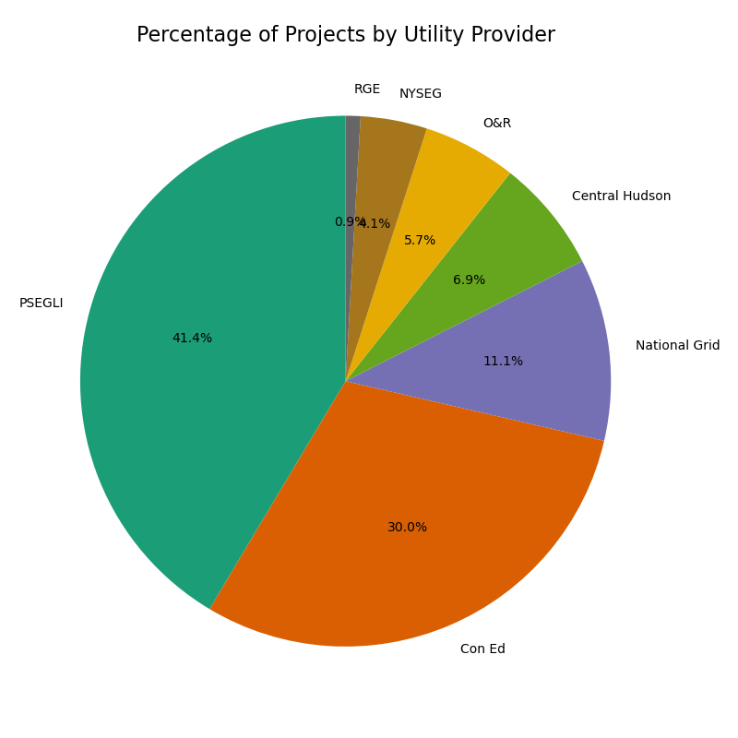
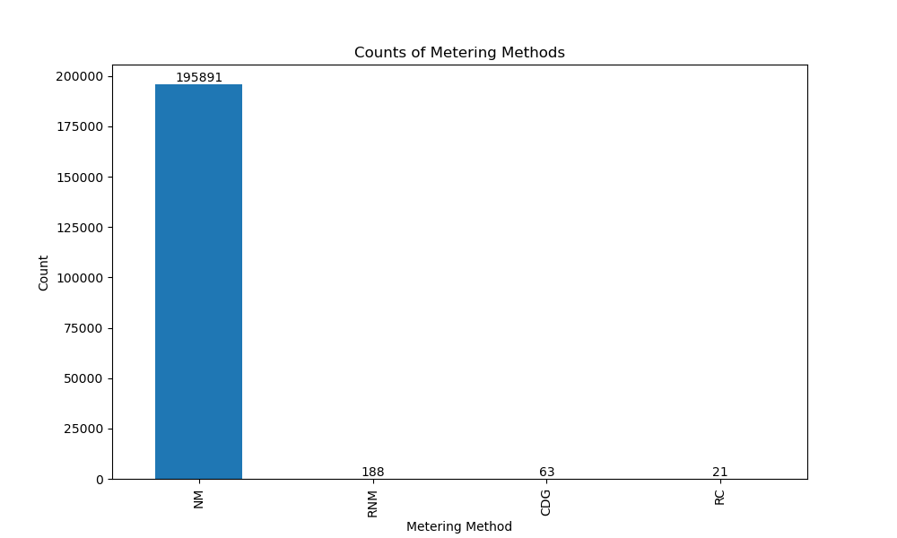
Data Visualization
The image is a pie chart titled "Percentage of Projects by Utility Provider”.
PSEGLI has the largest market share with 41.4% of the projects.
Con Ed comes in second with 30.0%.
National Grid has the third-largest share at 11.1%.
The remaining utility providers (RGE, NYSEG, O&R, Central Hudson) have smaller shares.
This bar chart provides a clear visual representation of the distribution of metering methods.
NM has the highest count by a significant margin.
RNM has the second-highest count.
CDG and RC have much lower counts compared to NM and RNM.

Slide 15
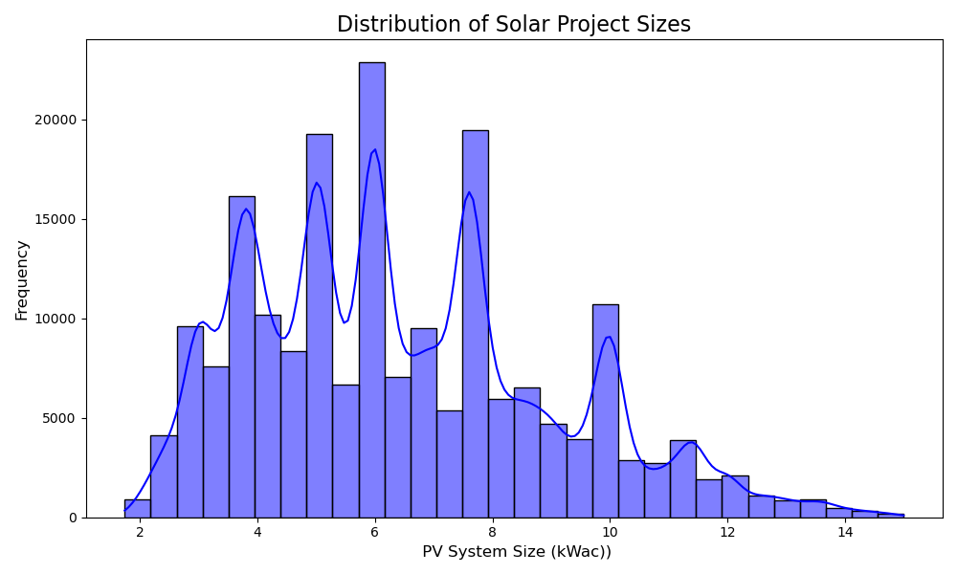
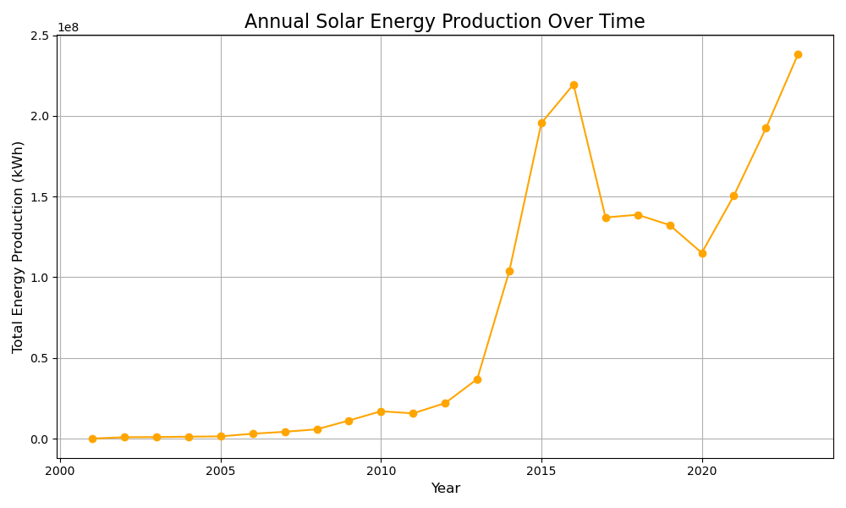
Data Visualization
Distribution Shape: The distribution appears to be multimodal with several peaks, suggesting that there are multiple clusters or groups of projects with different size ranges.
Most Frequent Size Range: The highest peak indicates the most common size range for solar projects.
Tail: The distribution seems to have a tail towards larger project sizes, indicating that there are a smaller number of very large projects.
The graph shows the trend of total energy production over the years, spanning from the 2000 to 2023.
Steady Growth: The line generally slopes upwards, indicating a steady increase in annual solar energy production over time.
Accelerated Growth: The slope of the line increases significantly after around 2010, suggesting a period of accelerated growth in solar energy production.
Fluctuations: There are some minor fluctuations in the production levels from year to year.

Slide 16
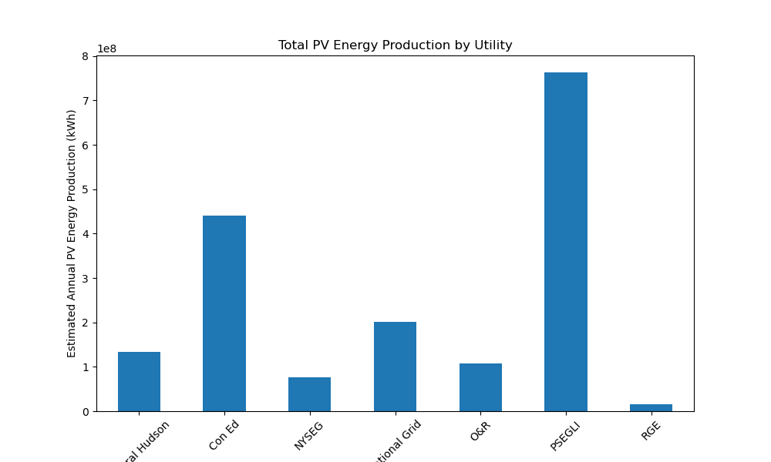
Data Visualization
Utility: The utility company or organization responsible for managing the power grid and distributing electricity.
PSEGLI has the highest total PV energy production, with the bar significantly taller than the others.
Con Ed has the second-highest production level.
Central Hudson and National Grid have moderate production levels.
NYSEG, O&R, and RGE have relatively lower production levels compared to the others.

Slide 17
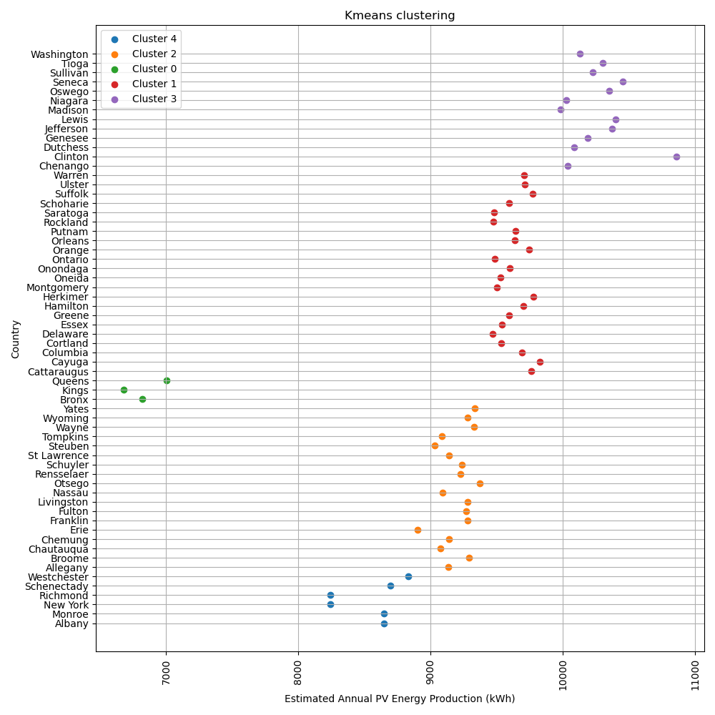
Model Selection
Model 1(K-means clustering)
K-means clustering is a popular unsupervised machine learning algorithm used to partition a dataset into a predefined
number of clusters (k). The goal is to group data points together that are similar to each other and dissimilar to points in other clusters.
Model Parameter : n_clusters=5,max_iter=300, random_state=42
Number of estimated clusters :5
Silhouette score : 0.6217

Slide 18
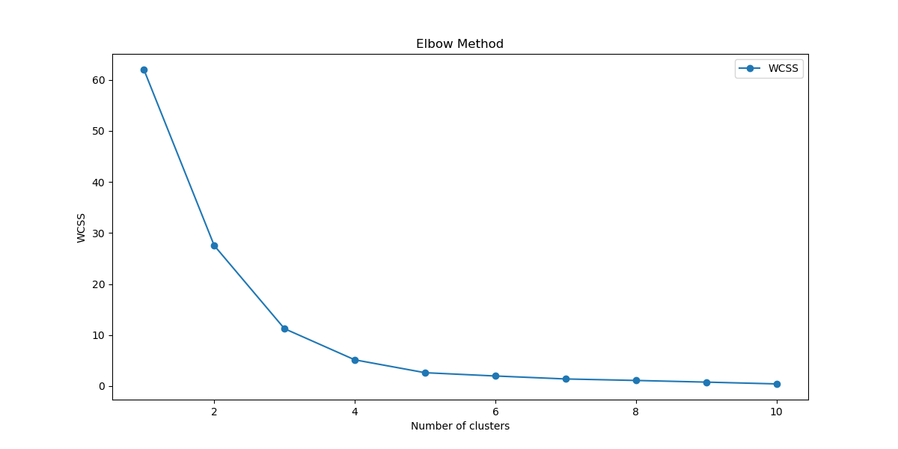
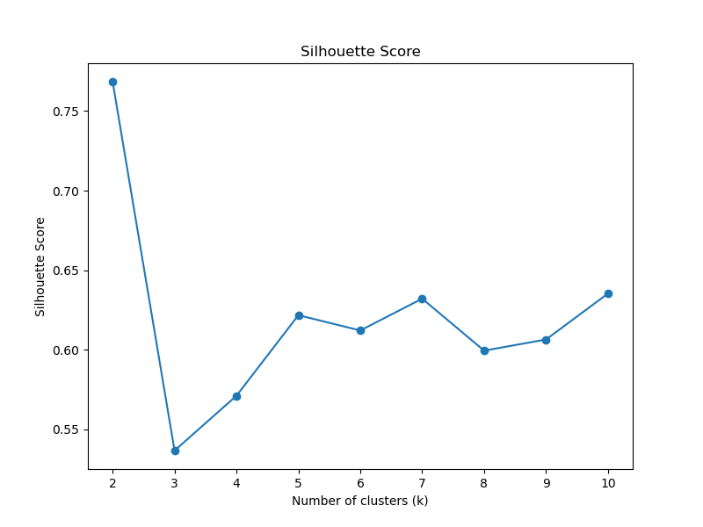
Model 1(K-means clustering)
The elbow method is a graphical technique used to determine the optimal number of clusters in a clustering algorithm, such as K-means.
It helps you find the "sweet spot" where adding more clusters doesn't significantly improve the clustering results.
By analysing Both graph we 5 choose optimal no. of cluster.
The Silhouette score is a metric used to evaluate the quality of clustering results.
It measures how similar a data point is to its own cluster compared to other clusters.

Slide 19
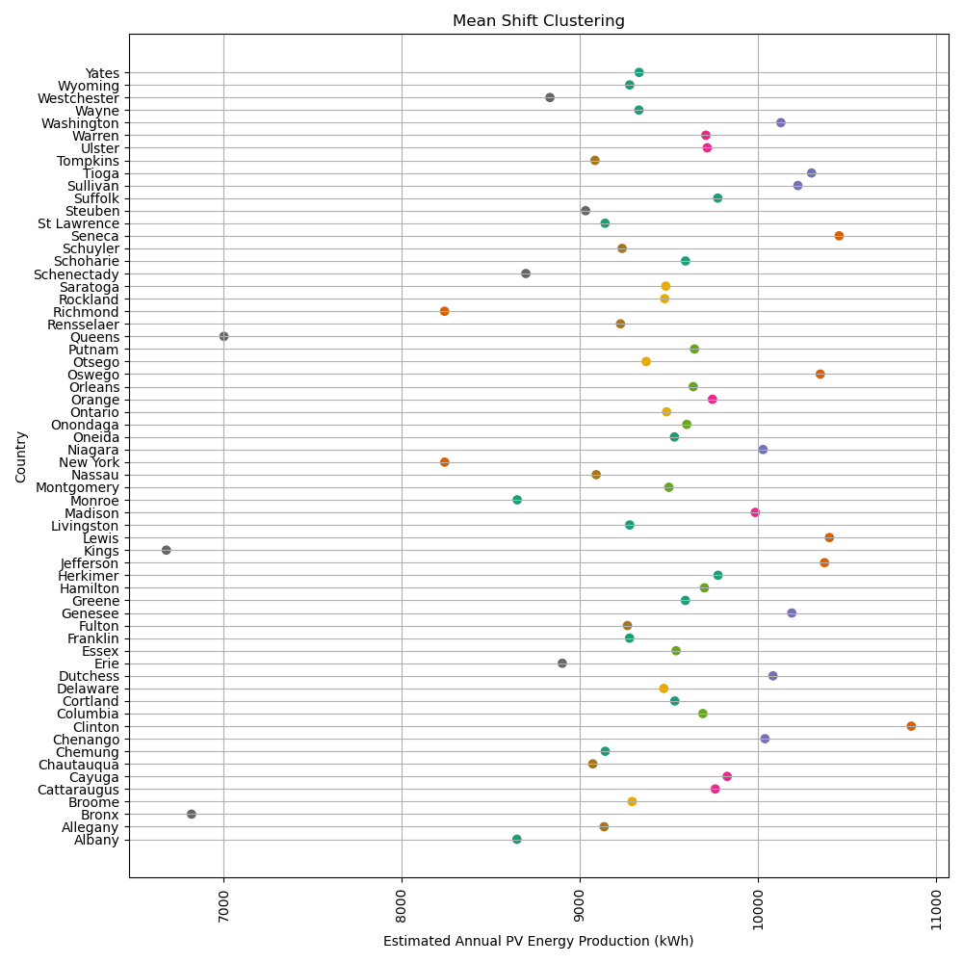
Model Selection
Model 2(Mean shift clustering)
Mean Shift is a non-parametric, density-based clustering algorithm.
It doesn't require specifying the number of clusters beforehand, making it adaptable to various data distributions.
Model Parameter :bandwidth = 2
Number of estimated clusters : 53
Silhouette score : 0.2512

Slide 20
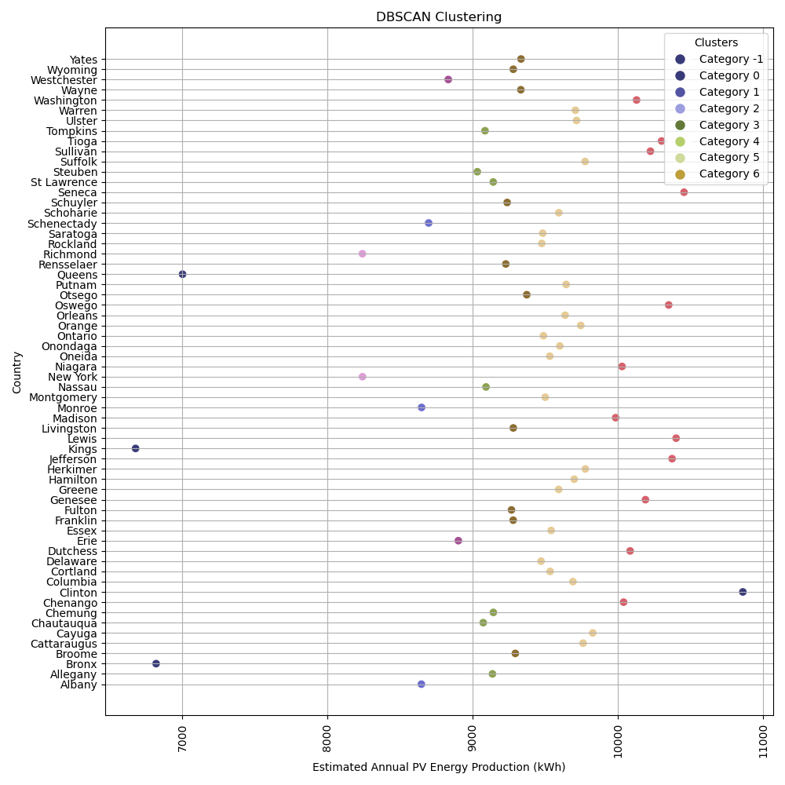
Model Selection
Model 3(DBSCAN)
DBSCAN (Density-Based Spatial Clustering of Applications with Noise) is a powerful clustering algorithm that groups data points based on their density.
Unlike K-means which requires you to specify the number of clusters beforehand, DBSCAN dynamically discovers clusters of varying shapes and sizes.
Model Parameter :eps=0.1, min_samples=2 * X_scaled.shape[1]
Number of estimated clusters : 8
Silhouette score : 0.5873

Slide 21
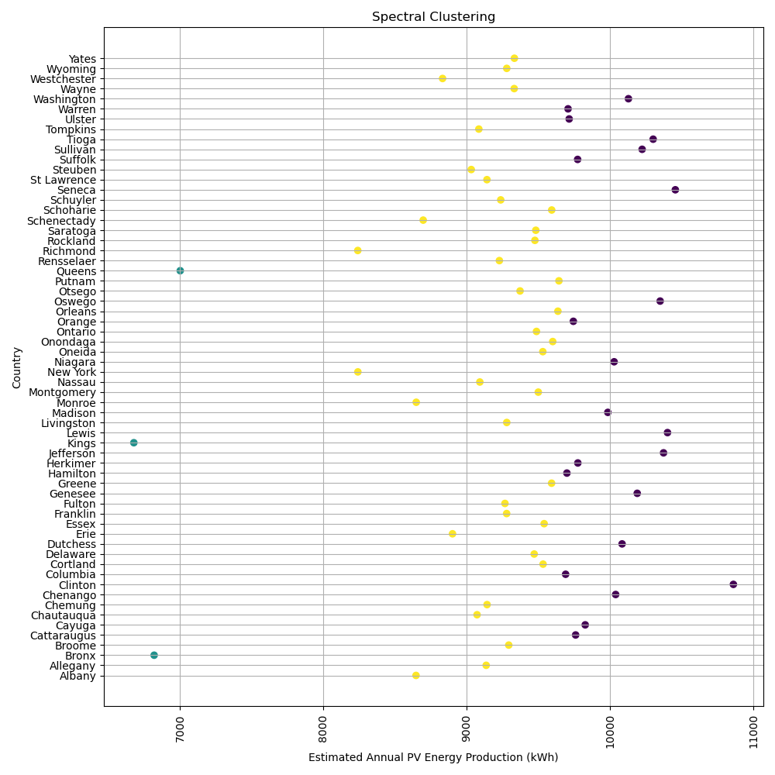
Model Selection
Model 4(Spectral clustering)
Spectral Clustering is a powerful clustering algorithm that leverages the spectral properties of the data to group similar data points together.
Model Parameter :affinity='rbf', assign_labels='kmeans‘
Number of estimated clusters : 3
Silhouette score : 0.5191

Slide 22
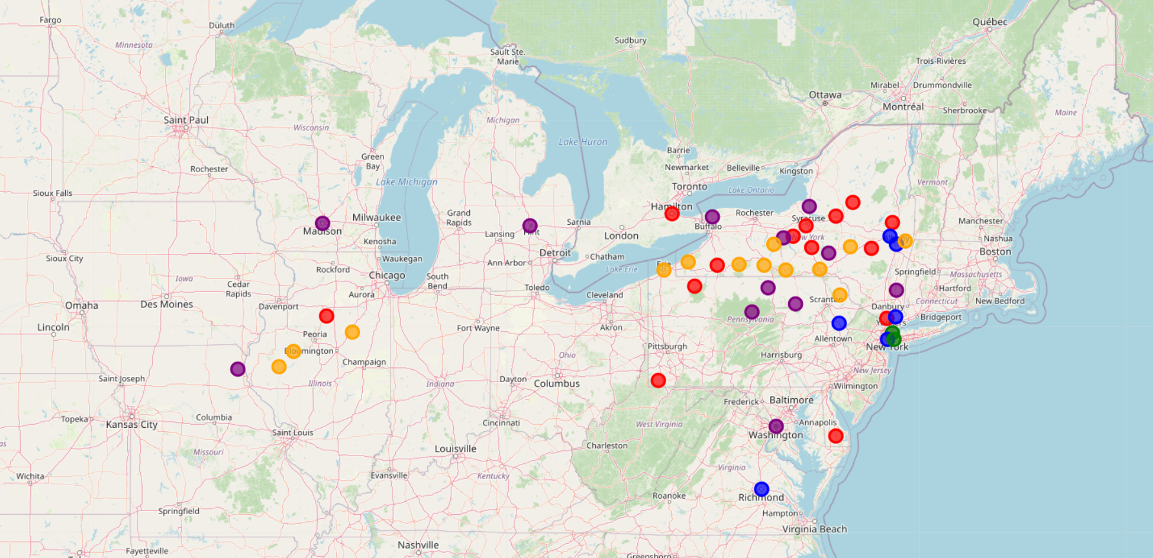
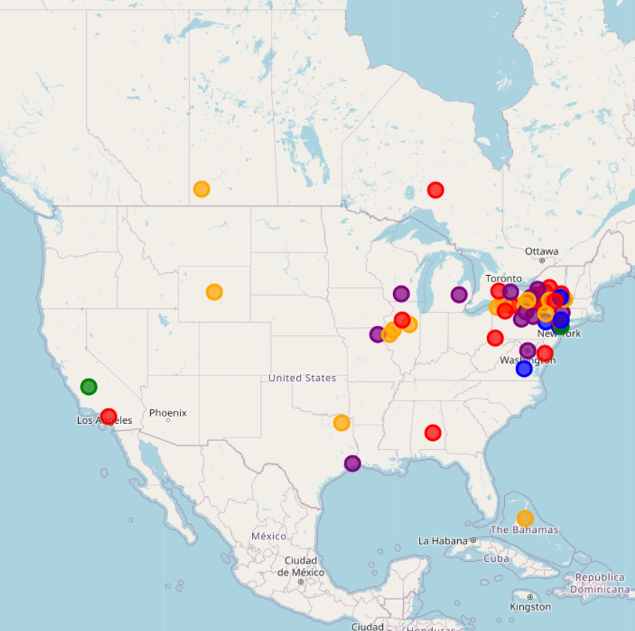
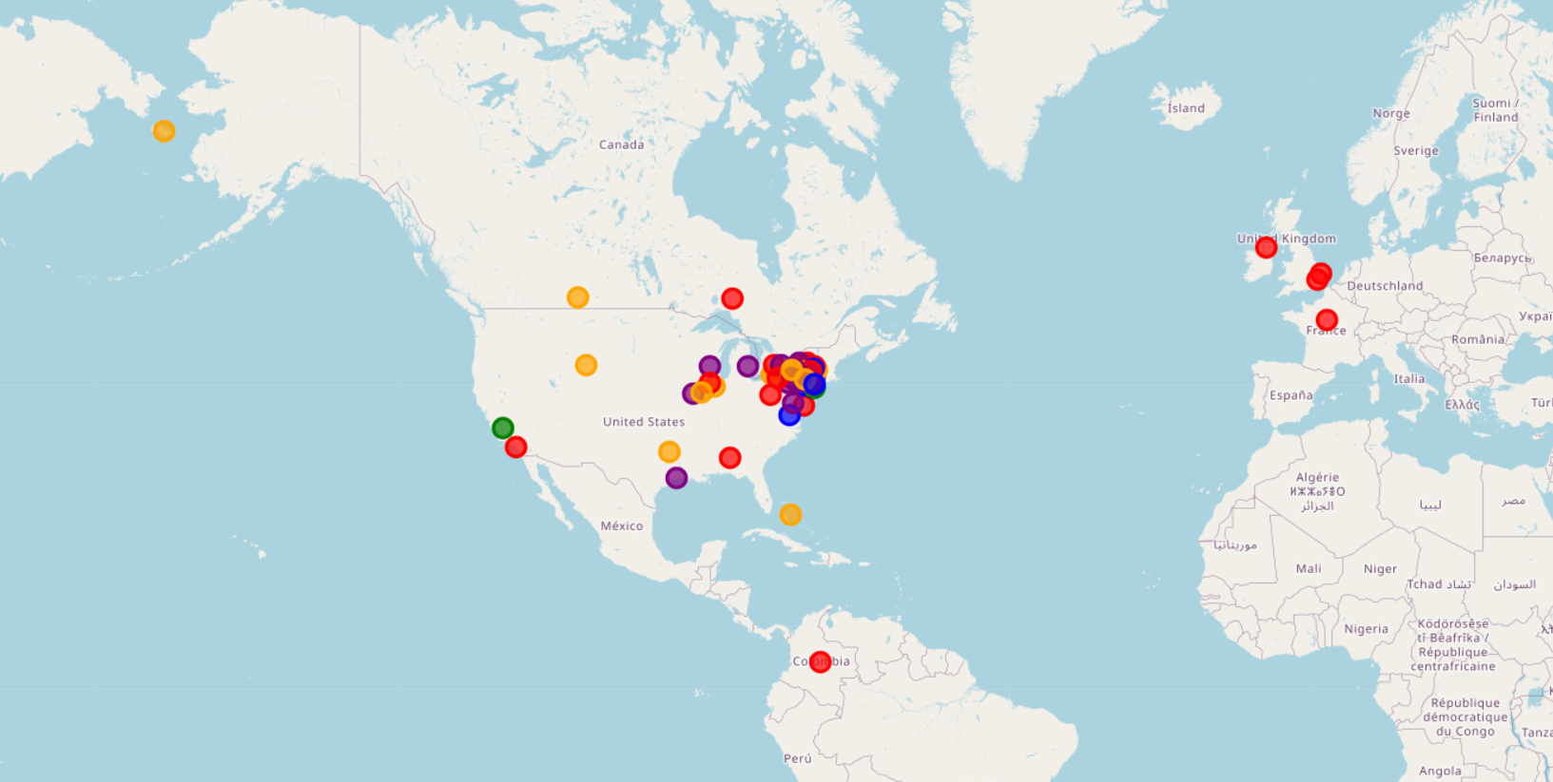
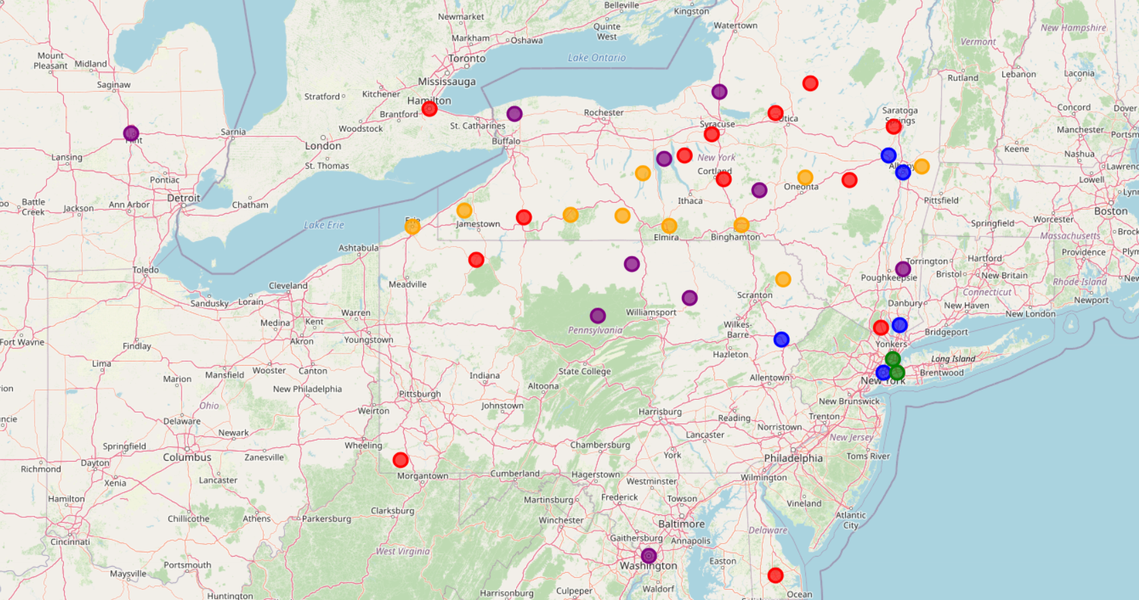
Geographic Visuals by clusters

Slide 23
Conclusion
For the Clustering Solar Energy Production Zones K-means clustering algorithm perform well.
It indicates that clustering results are generally well-separated and cohesive. This score suggests that clusters are reasonably well-defined.
The data points within each cluster are relatively similar to each other, and the clusters themselves are fairly distinct from one another
Model name | No. of clusters | Silhouette score
K-means | 5 | 0.6217
Mean shift | 53 | 0.2512
DBSCAN | 8 | 0.5873
Spectral clustering | 3 | 0.5191

Slide 24
Thank You
Presented By : Prathamesh Zanzane

